Slide 1
Applied Electromagnetics and Computational Intelligence Lab
Mapping meta-atoms to near field response for inverse design of optical metasurfaces​​
Andy G. Varner, Marshall B. Lindsayª, Charlie T. Vealª, Scott D. Kovaleskiª, Derek T. Andersonª
Stanton R. Price^{b}, and Steven R. Price^{b}
University of Missouri
Department of Electrical Engineering and Computer Science
May 1st, 2023 - SPIE DCS,
Orlando, FL
ªDepartment of Electrical Engineering and Computer Science, University of Missouri, Columbia, MO, USA ^{b}U.S. Army Engineer Research and Development Center, Vicksburg, MS, USA

Slide 2
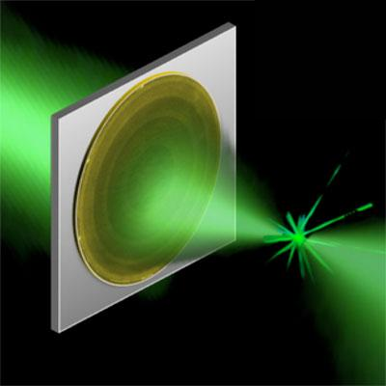
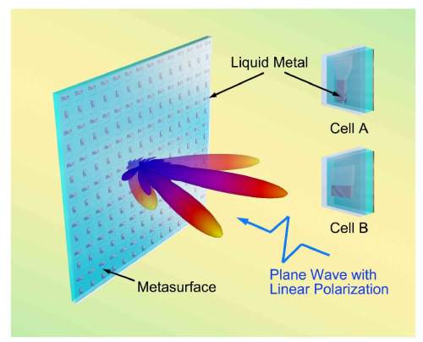
Introduction / Motivation
Optical metasurfaces
Phase Polarization | Amplitude Spatial control of an optical field
Notes:
What’s a good method for translating a physics-based design problem to a machine learning design problem?

Slide 3
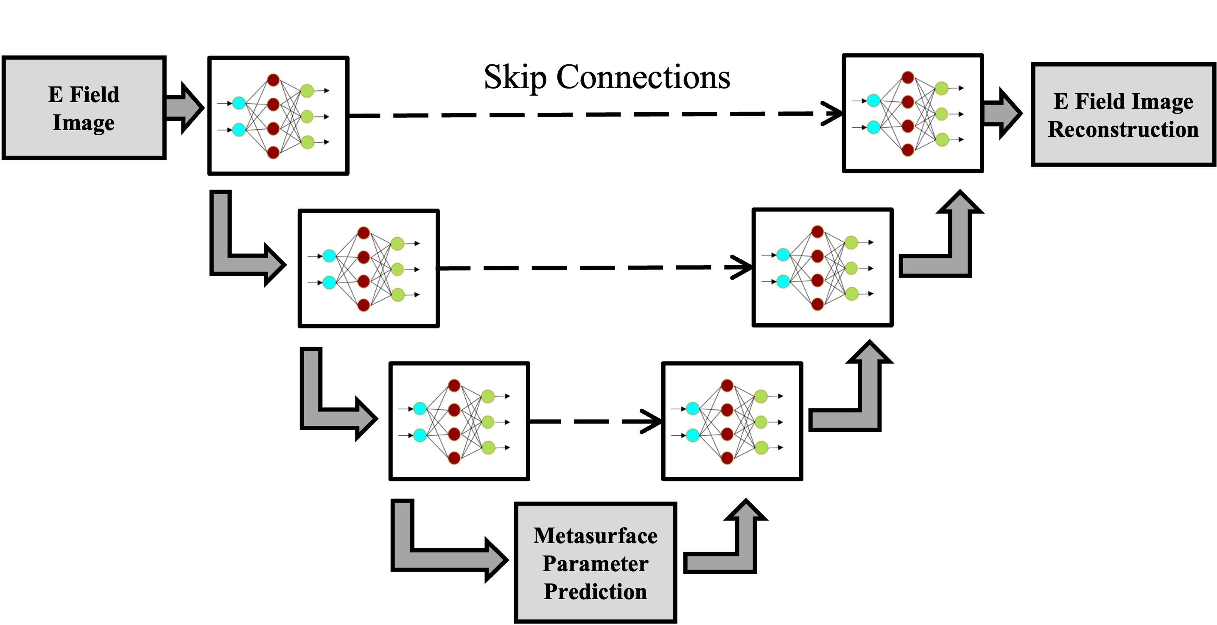
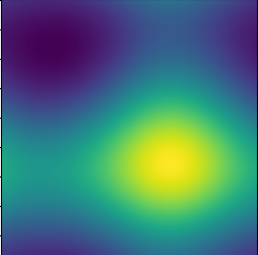
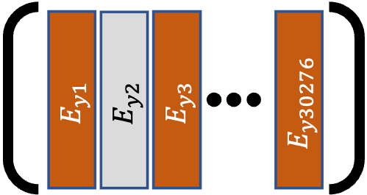
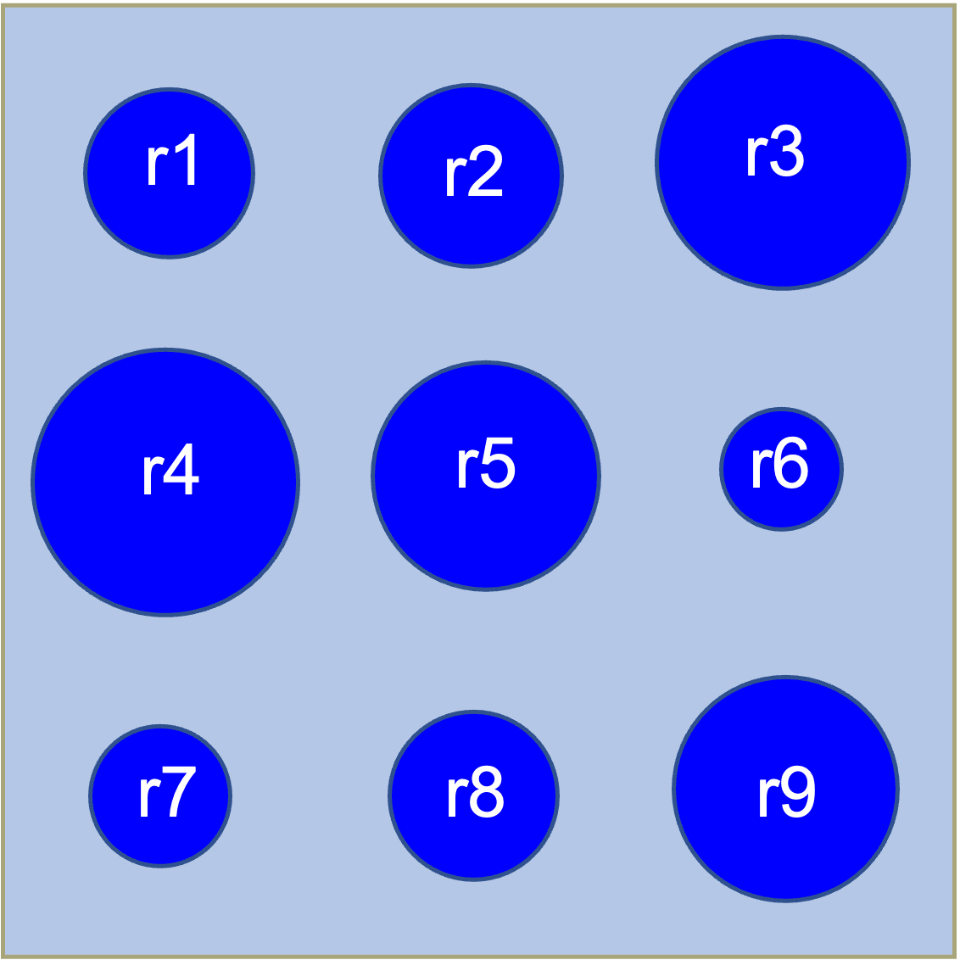
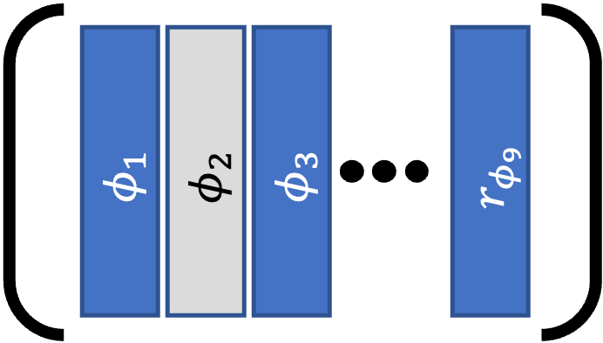
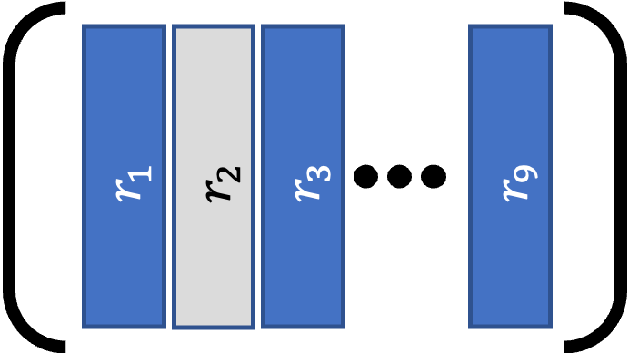



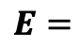

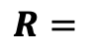
Process overview
A. Dataset creation and preprocessing
B. Model Architecture
Network Input
$$E=$$
$$E_{y1}$$
$$E_{y3}$$
$$E_{y30276}$$
$$E_{y2}$$
Forward Simulation
Predicted Phase Delays
Original
Phase Delays
Lagrange Interpolation
Compare/
Evaluate
$$R=$$
Predicted Radii
Reconstructed
E Field Image
Compare/
Evaluate
Meep
Resim
Lagrange Interpolation
Original
E Field Image
Taylor Series
Analysis
Phase Delays
Taylor Series
Analysis
Curvatures
Original Curvatures
Predicted Curvatures
Compare/Evaluate
Truth Labels
3
C. Process Predictions
D. Evaluate Predictions
Notes:
Things we had to consider in answering that question: 1. What’s suitable machine learning model, what’ s an appropriate archicture? 2. how do we generate data for that model? 3. We need an evaluation strategy.

Slide 4
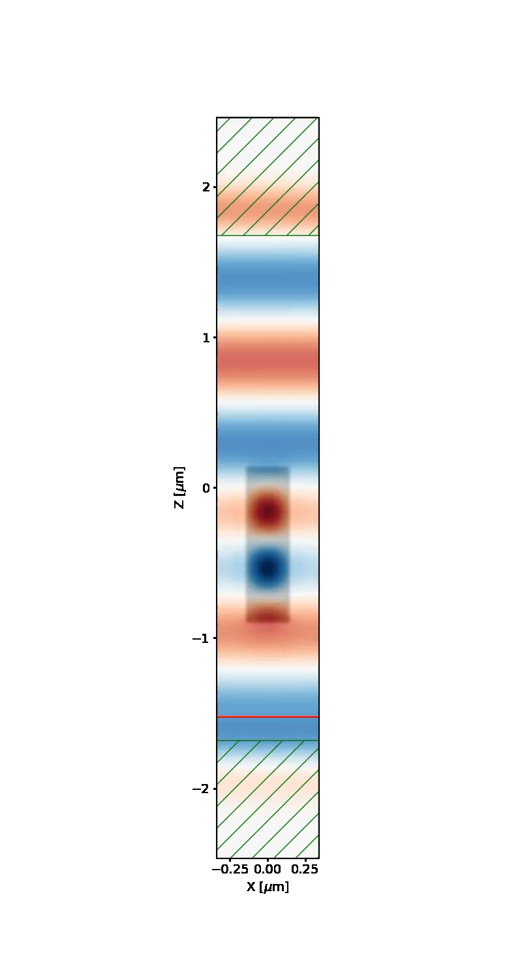
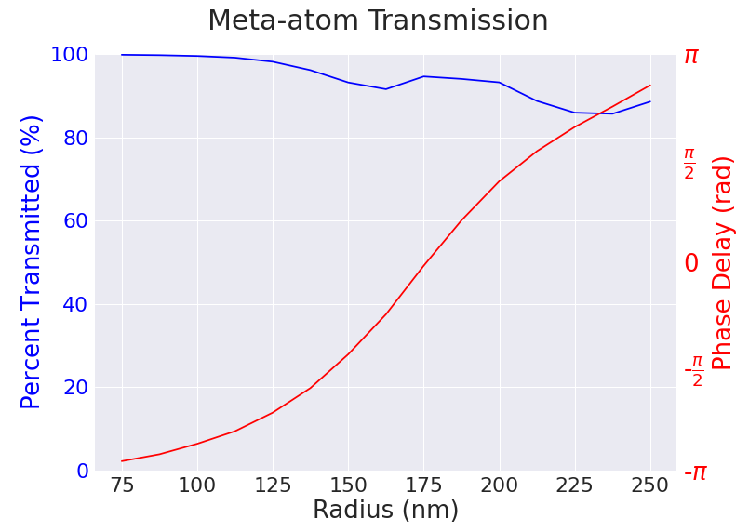
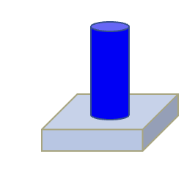
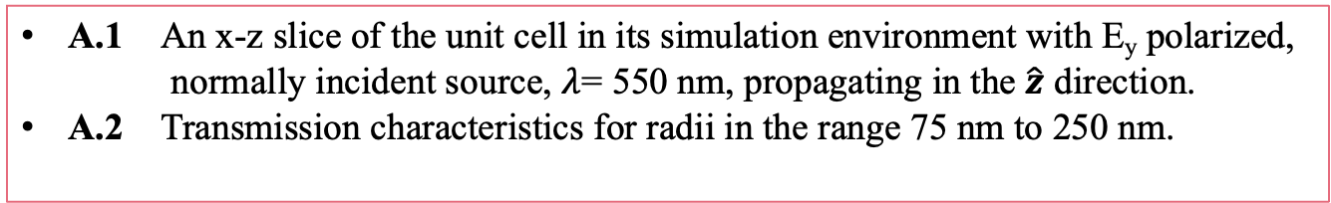
Dataset Creation: Map single pillar to phase delay
A.1
Simulation of a single meta-atom pillar under Bloch-periodic boundary conditions
PML
A.1 An x-z slice of the unit cell in its simulation environment with E_{y} polarized, normally incident source, $λ$= 550 nm, propagating in the $\hat{z}$ direction.
A.2 Transmission characteristics for radii in the range 75 nm to 250 nm.
A.2
Metasurface
Unit Cell
1020 nm
Electromagnetic
Source
z
x
PML
Notes:
We would like to build a system that does inverse design for any arbitrary metasurface. But to develop this work, we focused on a dielectric pillar, whose optical properties are well-understood. We used an electromagnetic simulation tool, meep, to conduct simulations that allow us to confirm that, for this meta-atom, phase delay is a function of radius, and we also get high transmission over the range. Now we can interpolate the relationship between meta-atom geometry and phase delay such that we can confidently associate a phase delay with any pillar given radius in this range. And this range is important, it is the range where these subwavelength resonances occur, which are responsible for the phase delays we desire.

Slide 5
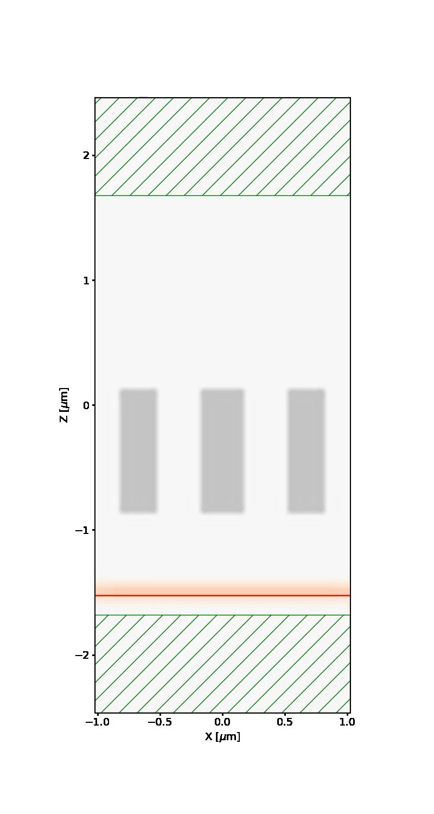
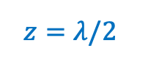
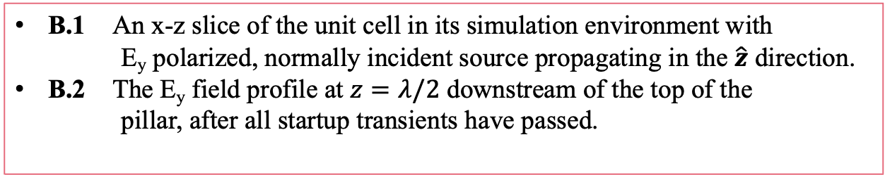
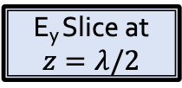
Dataset Creation: Map 3x3 pillar neighborhoods to electric field
2040 nm
Extension of simulation to 3x3 set of meta-atoms
B.1
PML
B.1 An x-z slice of the unit cell in its simulation environment with E_{y} polarized, normally incident source propagating in the $\hat{z}$ direction.
B.2 The E_{y} field profile at $z=λ/2$ downstream of the top of the pillar, after all startup transients have passed.
$$z=λ/2$$
x = 2040 nm
1020 nm
Metasurface
Unit Cells
B.2
E_{y} Slice at $z=λ/2$
y = 2040 nm
Electromagnetic
Source
PML
z
x
Notes:
Extend the simulation to 3x3 neighborhoods for better design accuracy. This introduces complexity – we cannot associate a single phase delay with a 3x3 set of pillars with random radii because of nonlocal interactions. Because phase information is contained in the electric field, we examine a slice of the y polarized field downstream of the tops of the pillars

Slide 6
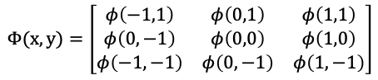
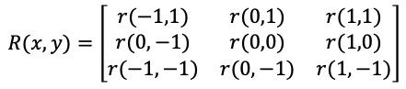
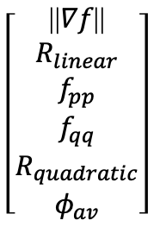
Dataset Creation: The consideration of nearest neighbors yields curvature
Curvatures
$$R(x,y)=\left[\begin{matrix}r(−1,1) & r(0,1) & r(1,1) \\ r(0, −1) & r(0,0) & r(1,0) \\ r(−1,−1) & r(0,−1) & r(1,−1)\end{matrix}\right]$$
Blobs
$$Φ(x,y)=\left[\begin{matrix}φ\left(−1,1\right) & φ\left(0,1\right) & φ\left(1,1\right) \\ φ\left(0, −1\right) & φ\left(0,0\right) & φ\left(1,0\right) \\ φ\left(−1,−1\right) & φ\left(0,−1\right) & φ\left(1,−1\right)\end{matrix}\right]$$
Bars
Use Taylor Series Analysis to approximate $Φ(x,y)$
Saddle
Curvature Parameters
$$\left[\begin{aligned}\text{||}∇f\text{||} \\ R_{linear} \\ f_{pp} \\ f_{qq} \\ R_{quadratic} \\ φ_{av}\end{aligned}\right]$$
Flat
Notes:
Because we have a mapping from phase delay to single pillar, we can associate each pillar with its local phase delay. The total phase function due to a neighborhood of pillars can be approximated by the second order, two-dimensional Taylor series expansion. This process yields curvature parameters that can be used as machine learning labels. Using these curv. Parameters, you’re giving labels for nonlocal interactions.
fpp, fqq are eigenvalues of the hessian matrix

Slide 7
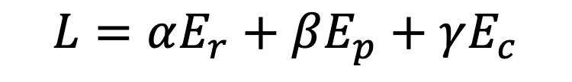
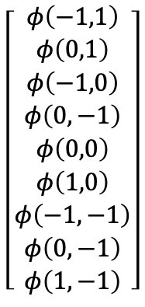
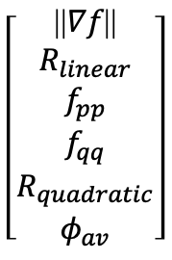
Experiments: Objective function
Ground Truth
Reconstruction
Curvature
Phase
$$\left[\begin{aligned}φ\left(−1,1\right) \\ φ\left(0,1\right) \\ φ\left(−1,0\right) \\ φ\left(0,−1\right) \\ φ\left(0,0\right) \\ φ\left(1,0\right) \\ φ\left(−1,−1\right) \\ φ\left(0,−1\right) \\ φ\left(1,−1\right)\end{aligned}\right]$$
$$\left[\begin{aligned}\text{||}∇f\text{||} \\ R_{linear} \\ f_{pp} \\ f_{qq} \\ R_{quadratic} \\ φ_{av}\end{aligned}\right]$$
Predicted Phase Delays
$$L=αE_{r}+βE_{p}+γE_{c}$$
7
Notes:
We have labels for each pillar in the 3x3 neighborhood, as well as the curvature labels which approximate each. We can think of the phase parameters as absolute measurements, and we can think of the curvature parameters as relative measurements – The relationship among the neighbors with respect to phase. And part of this work is assessing this abs. vs. relative comparison. We want to learn a mapping between these electric field slices and a 3x3 pillar distribution. So we have this huge image, representing a slice of the electric field, and we’d like to predict a small vector of phase values and a small vector of curvature parameters for that field. The machine learning community has solution for this -> The autoencoder takes a high dimensional input, does dimensionality reduction and finds the dominant patterns in the latent space. Then it uses those learned constituent parameters to reconstruct the image. We don’t just want to reconstruct an image. We want to kind of hone the network’s ability to find those dominant patterns and actually make predictions from the latent space. We chose the unet because they have shown success in other fields– they have a latent space we can regularize. The main difference in what we’re doing compared to the rest of the community is we’re doing multicriteria loss applied at the latent space. This is kind of a unique way to use this architecture, where we add constraints in the latent space in order to learn physics knowledge. So our multicriteria loss function has three terms: reconstruction loss, phase loss, and curvature loss. We can tune these, and we can turn them on and off, to try and steer the model to make these predictions.
The experiments are designed to help us understand the model's ability to learn physics in the latent space.
###
We don’t wan to throw away the relationship between e field pack to pillars, so we add the second half of the architecture (decoding stage – learn mapping back from pillars to e field in hopes that it helps us learn). If it made a good prediction about pillars, it should be able to reconstruct the image.. Definitely point out: main difference we’re doing is multicriteria loss applied at the latent space. Kind of a unique way of using this unet. Move to multicriteria loss. Three things to consider when trying to steer this model to make predictions: reconstructions: if you consider recons only, the model ”cheats” – it doesn’t learn curvature or phase – no inverse design knowledge. So we add constraints in the latent space in order to learn the physics knowledge. curvature tries to get at relationship I have to my neighbors. Relative vs. absolute measurements. Optimizing for phase specifically is an absolute measurement. You would think if you min. the absolute, you’d also get the relative.

Slide 8
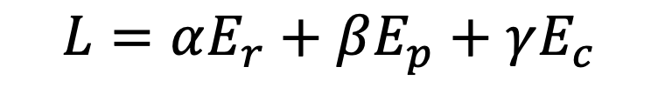
Experiments: Loss analysis
$$L=αE_{r}+βE_{p}+γE_{c}$$
Training Analysis
Validation / Test Analysis
8
Notes:
Describe the models. So we’re looking at total loss in the first column, and deconstructed loss in the rest of the graphs. The thing that really stands out here is that reconstruction loss is always very low: these results hint that good reconstructions do not indicate good curvature and phase predictions. Also since recon dominates the loss function, we “even the numerical playing field” by setting beta and gamma high compared to alpha.

Slide 9
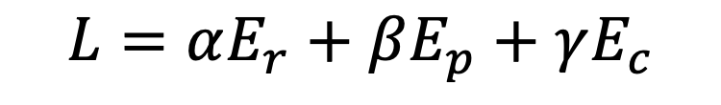
Experiments: Qualitative results, reconstruction
$$L=αE_{r}+βE_{p}+γE_{c}$$
Training Dataset
Validation Dataset
Notes:
Essentially zero. Does reconstruction help us learn good curvature and phase?

Slide 10
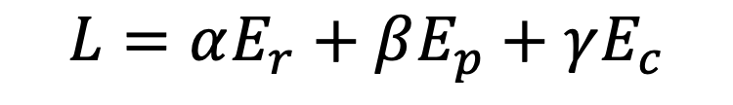
Experiments: Quantitative results, phase
$$L=αE_{r}+βE_{p}+γE_{c}$$
Training Analysis
Validation / Test Analysis
10
Notes:
RC model not great at predicting phase

Slide 11
Experiments: Quantitative results, curvature
Experiments- Quantitative Results
$$L=αE_{r}+βE_{p}+γE_{c}$$
Training Analysis
Validation / Test Analysis
11
Notes:
Linear rot [-pi, pi] quadratic rot [pi/2, pi]. Expect minimizing curvature -> minimize phase. Linear rotation as a truth label may not make a lot of sense. There might be a different forumulation of neighbor-neighbor comaprisons that are more machine-learning appropriate. What makes sense for engineers- curvature – may not make sense to a machine.

Slide 12
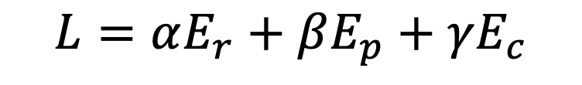
Evaluation: Resimulation
$$L=αE_{r}+βE_{p}+γE_{c}$$
Training Dataset
Validation Dataset
Notes:
Linear rot [-pi, pi] quadratic rot [pi/2, pi]. Expect minimizing curvature -> minimize phase.

Slide 13
Conclusion
Notes:
We built a custom machine learning model with the aim of turning a physics design problem into a machine learning problem.
We build a dataset that considers local neighborhoods of metasurfaces and their impact on near field electric field.
We found that this system is excellent at image reconstruction, but image reconstruction does not necessarily indicate that physics was learned.

Slide 14
Future work
Investigate multi-criteria loss
Explore other geometries and materials
Make near to far field connection for applications
Simplify curvature parameters
Notes:
Future work involves a simplification of the physics. We can use first and second derivatives rather than the more complicated Taylor Series curvature parameters

Slide 15
Discussion

Slide 16
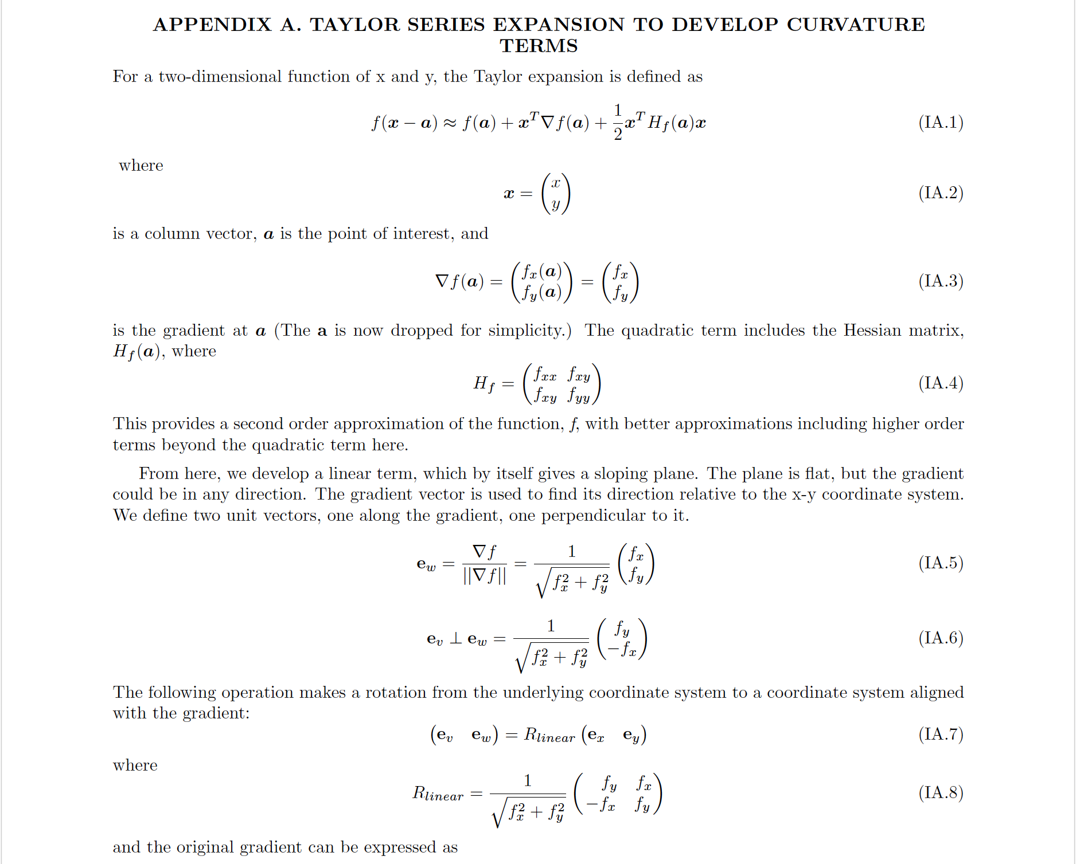
Appendix: Taylor series expansion

Slide 17
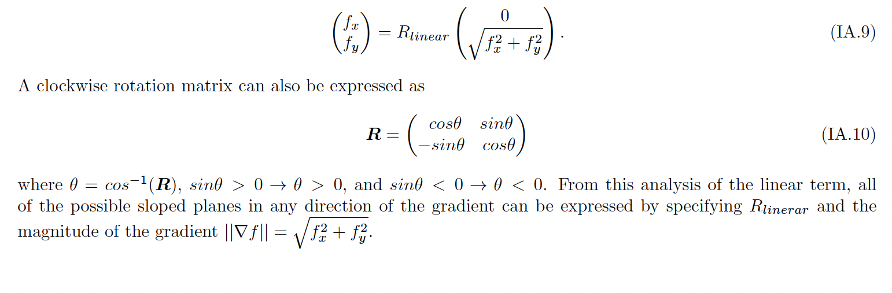
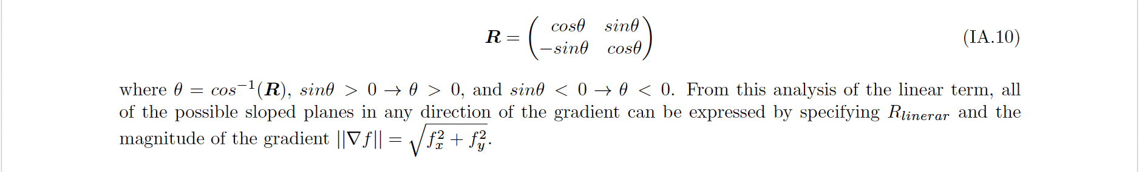
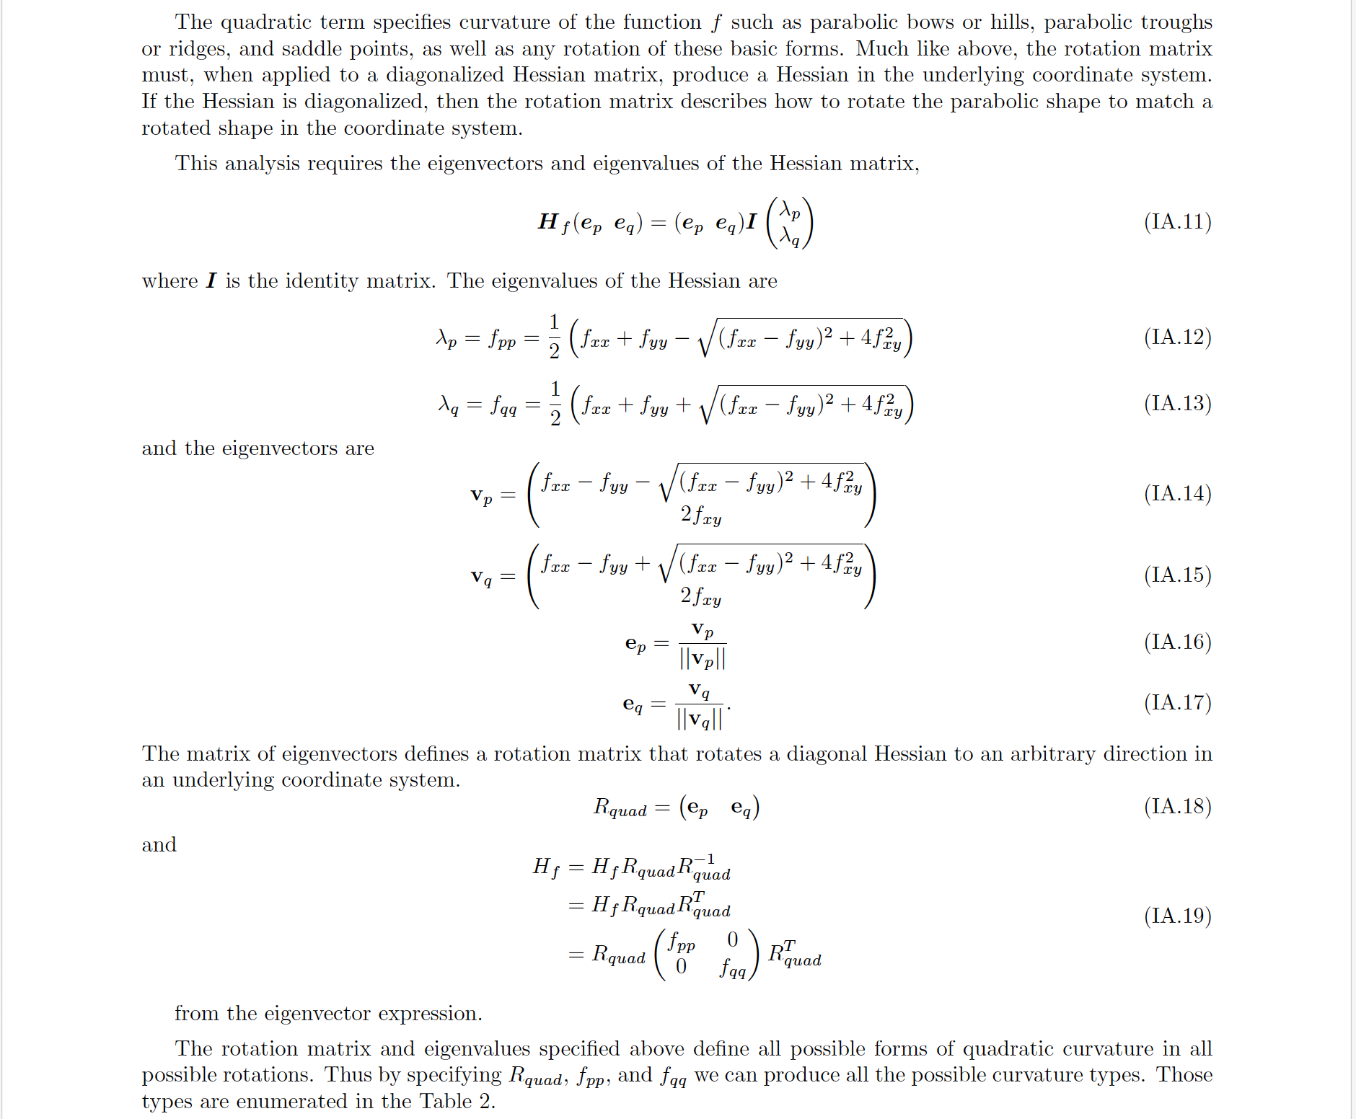

Slide 18
